Slide 1
Flight Management System
Desktop application Project for DBMS lab by
-Saikat Mitra(12021002016069)
-Subhajoy Mukherjee(12021002016029)

Slide 2
Introduction
An airport management system (AMS) is a software solution that helps airports to manage their operations more efficiently and effectively. AMS can be used to automate and streamline a wide range of tasks, including passenger processing, aircraft scheduling, and runway management. Etc.
One of the most important features of an AMS is the ability to track and manage flight information. This includes information such as airline name, flight number, arrival time, arrival runway, departure time, departure runway, destination, and number of passengers. This information is essential for airports to plan and coordinate their operation.

Slide 3
Key features of the application
These are some of the key pieces of information that are tracked and managed by an AMS. This information is used to:
Plan and coordinate airport operations: AMS uses flight information to plan and coordinate airport operations, such as staffing levels, runway usage, and baggage handling.
This application provides the function to change the flight’s arrival/departure time to ‘arrived’ , ‘departed’ , ‘delayed’ status.
a warning message will be displayed if the new entry's arrival/departure time and runway numbers are same as that of another flight's.
It moves the data of those flights whose arrival and departed time are set to ‘arrived’ and ‘departed’ respectively to another table.

Slide 4
Key features of the application
a warning message will also be displayed if the arrival and departure time for the new entry are same and if we try to enter new data for a flight which already exists in the database.
we can filter the data in the database according to airlines, flight number, arrival time, arrival runway, departure time, departure runway, number of passengers, destination and status.
we can also view all the data stored in the database, we can update the data for any flight, we can also remove data for a particular flight or we can delete all the data in the database.

Slide 5
Softwares used
Python3(backend)
Kivy & kivymd(frontend)
Mysql rdbms(database)
Mysql connecter (database connecter)
Pip3(package installer)

Slide 6
Hardware used
Intel hd graphics (family)
Intel dual core i5
Ram(crucial ram 8gb ddr4 3200 mhz cl22)

Slide 7
Source code
Github link : https://github.com/Anonymous468/Flight-Management-System

Slide 8
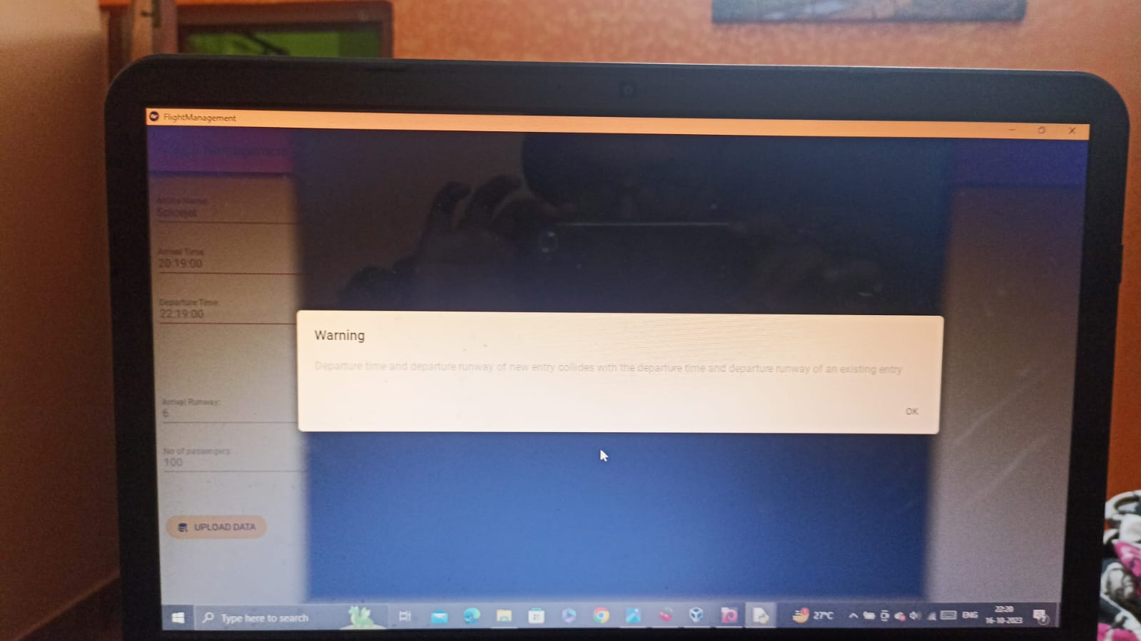
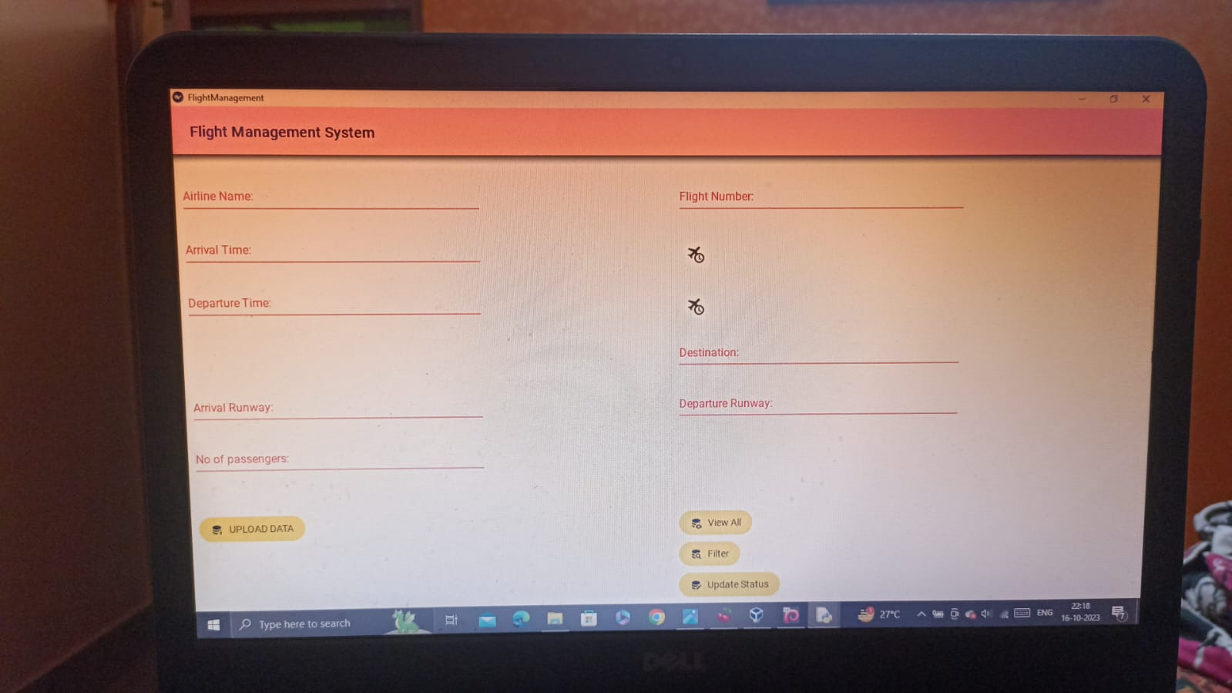
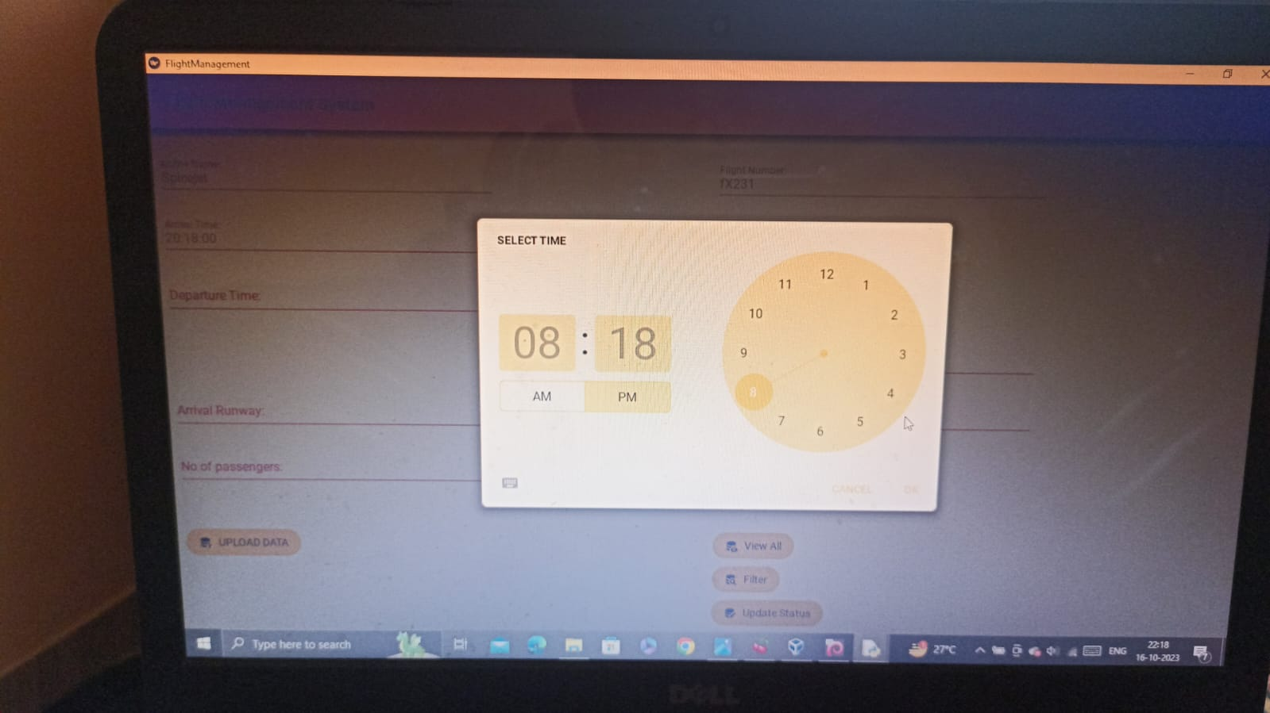
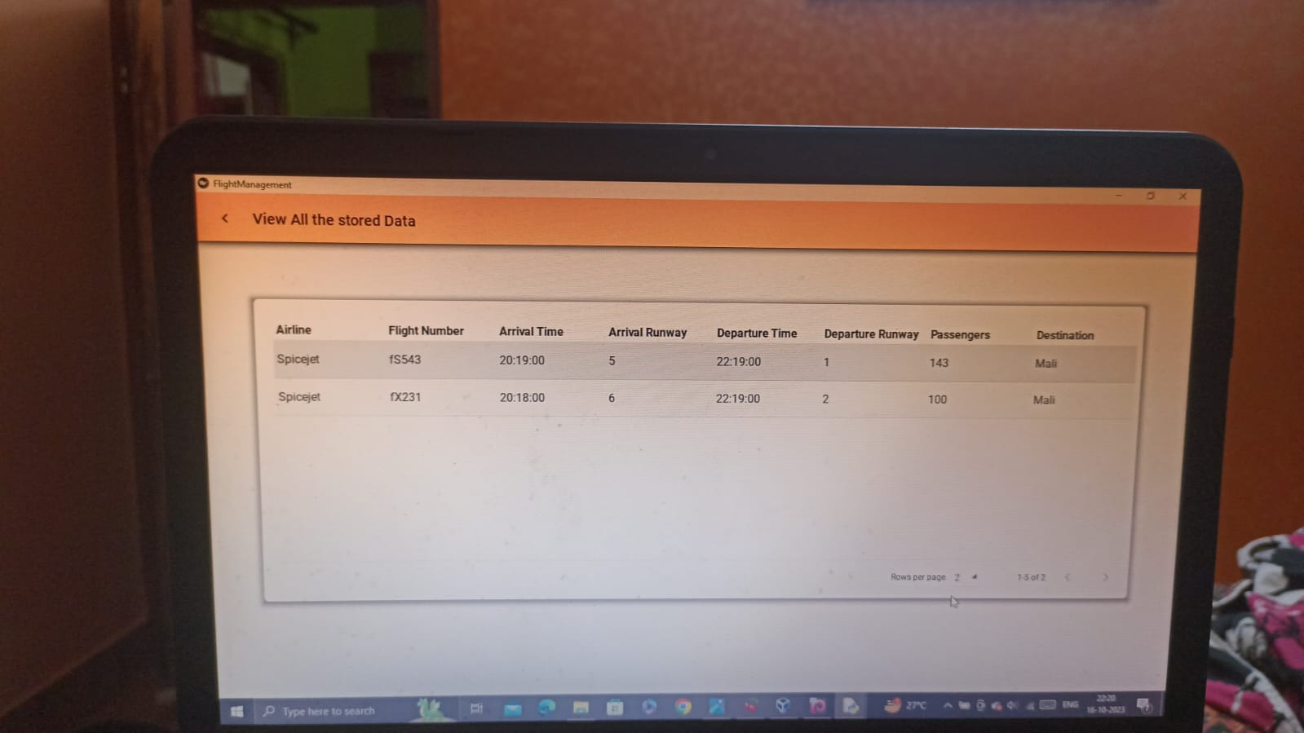
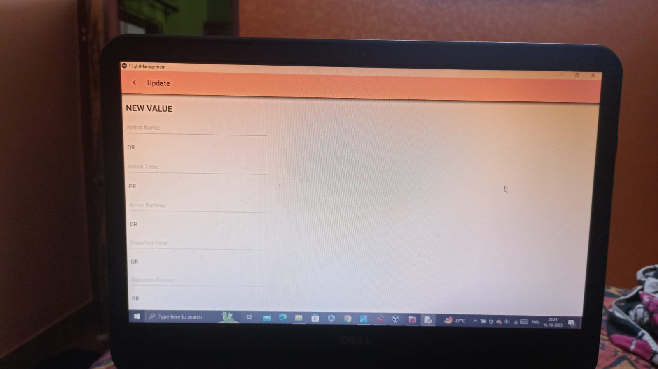
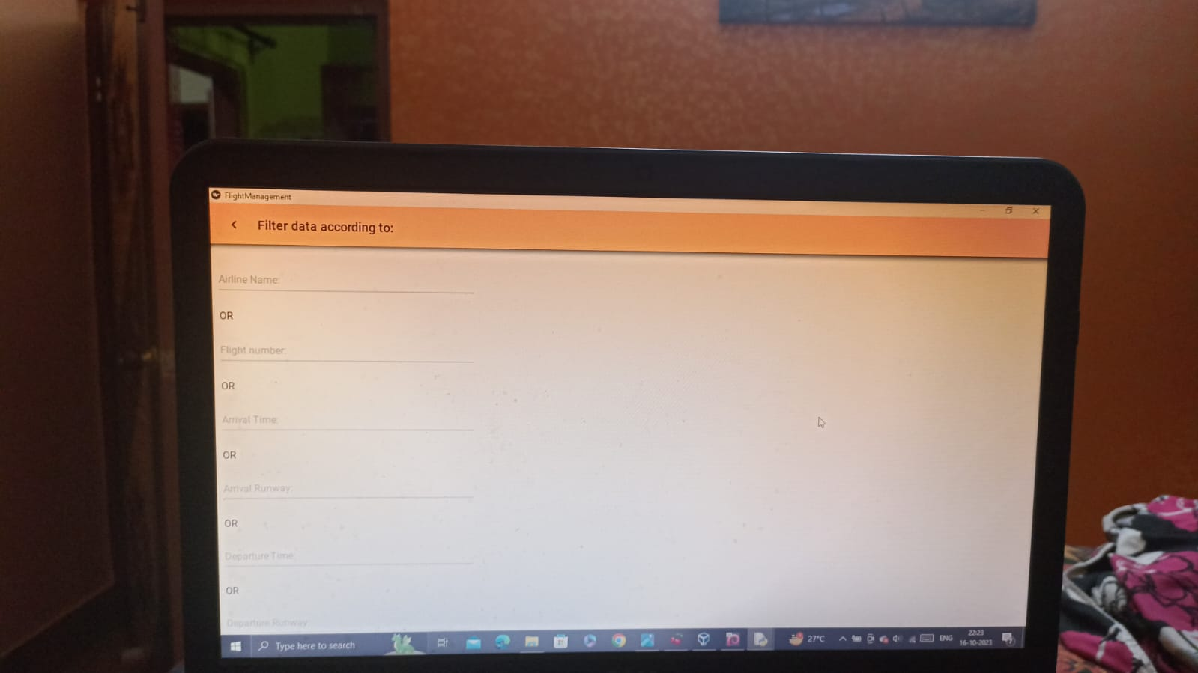
Working images

Slide 9
Future scope
In future we can use the advanced machine learning & deep learning algorithms for image processing and also use some automated sensors & cameras to collect the raw data. By this implementations we can make the full flight management system automated where nobody is needed to put the data inside database or update the data. Everything will be updated and included in the databases by the real-time image processing mechanisms. This also make the process smoother and hustle free and time saving.

Slide 10
conclusion
For each and every airlines flight management system is very important as there they need to keep track of each flight’s status , locations & acomodations. From this point of view this project is very much real world oriented.
This project also helps us to manage some real world data.

